Slide 1
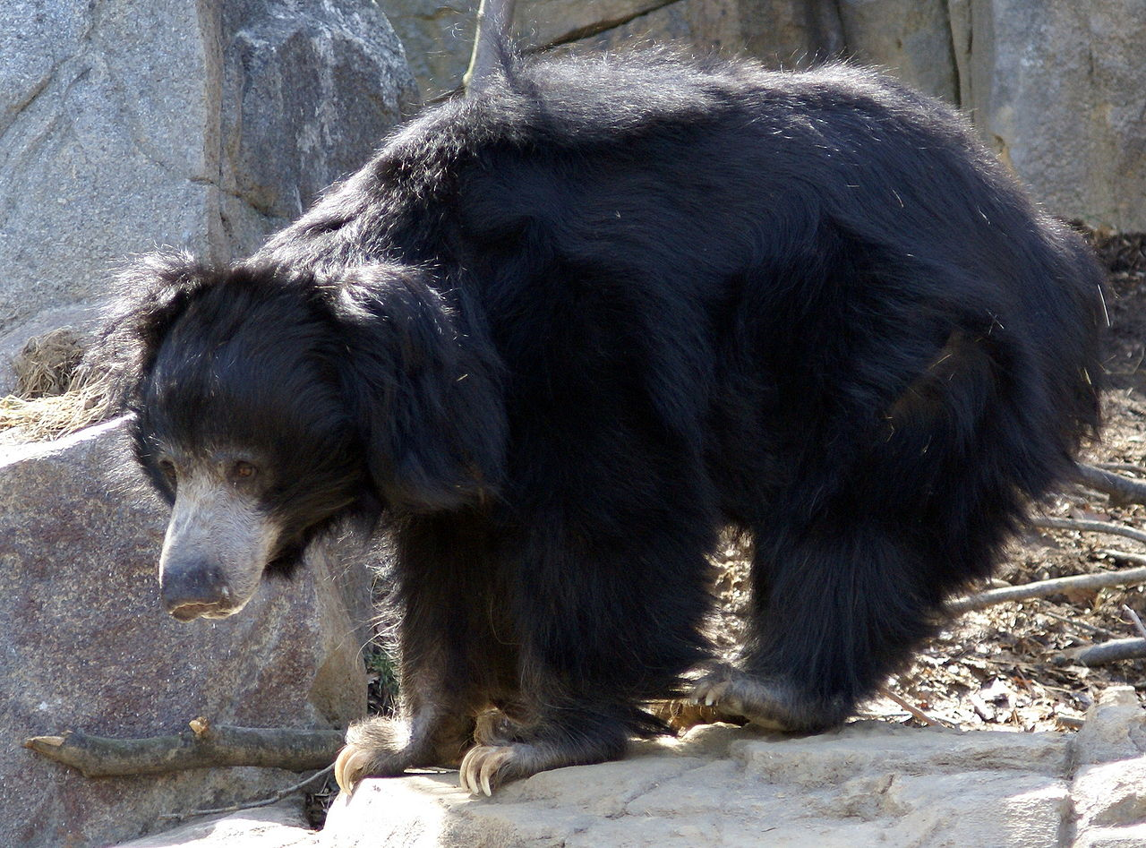
Dimensionality Reduction
Part 1 of 2
Emily M. and Greg C.
Look for the bare necessities
The simple bare necessities
Forget about your worries and your strife
I mean the bare necessities
Old Mother Nature’s recipes
That bring the bare necessities of life
– Baloo’s song [The Jungle Book]
The real Baloo
"Sloth Bear Washington DC" by Asiir - http://en.wikipedia.org/wiki/File:Sloth_Bear_Washington_DC.JPG. Licensed under Public Domain via Commons - https://commons.wikimedia.org/wiki/File:Sloth_Bear_Washington_DC.JPG#/media/File:Sloth_Bear_Washington_DC.JPG
http://scikit-learn.org/stable/modules/manifold.html

Slide 2
Dimensionality Reduction: Outline
Definition and Examples
Principal Component Analysis and Singular Value Decomposition
Reflections on Dimensionality Reduction
“Pset” office hours

Slide 3

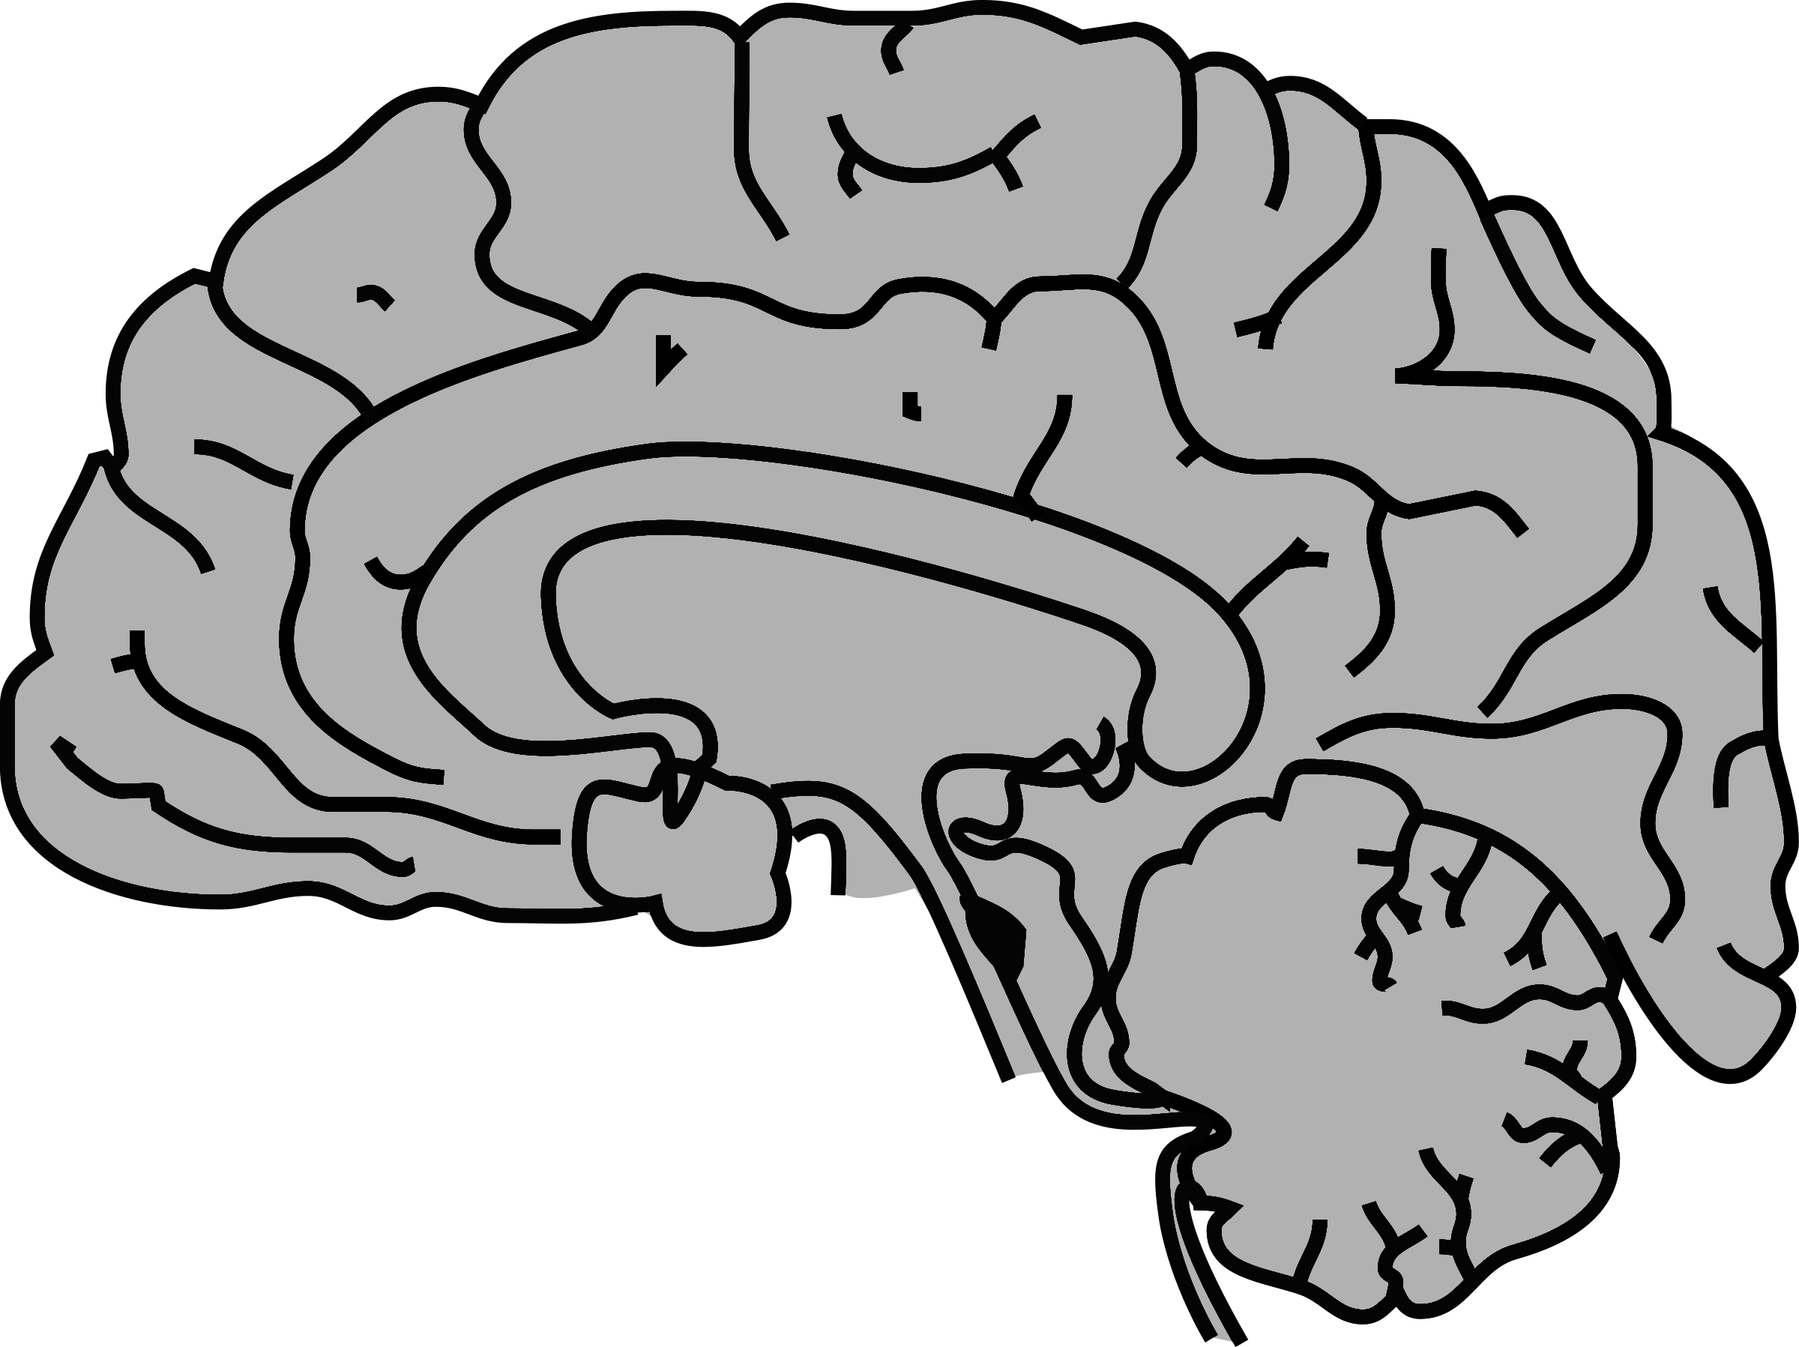

Dimensionality Reduction
Each datum is a vector with m values aka dimensions
Data
Reshape
Dim. Red.
m = # pixels (256^2)
1
-5
6
3
1
-5
1 | 6
-5 | 3
1
-5
6
3
1
-5
m = # voxels (10^5)
m = # features (??)
Datum
Dimensionality Reduction
A procedure that decreases a dataset’s dimensions from m to n, n < m.
https://openclipart.org/detail/211774/matticonsimagexgeneric
https://openclipart.org/detail/193562/simple-brain
https://openclipart.org/detail/219976/hypercube

Slide 4
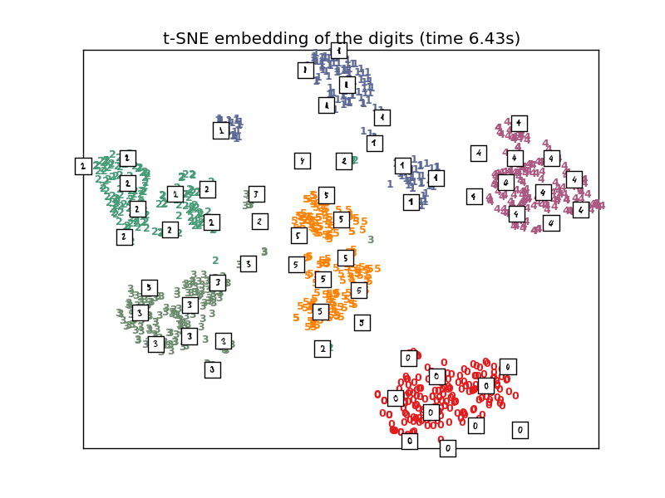
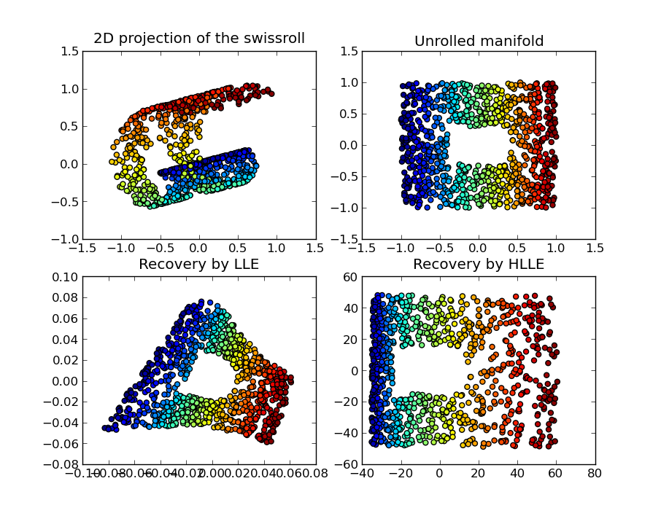
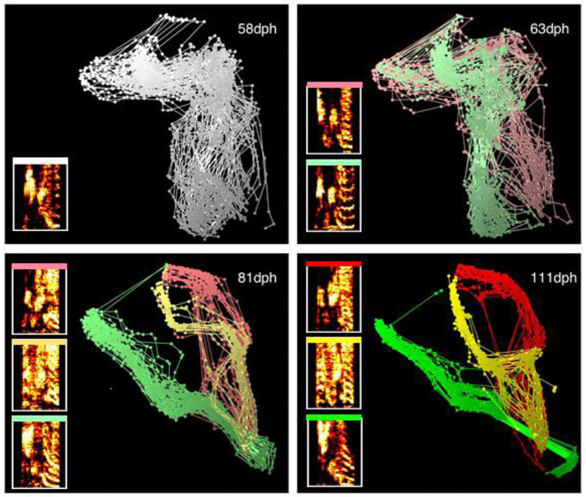
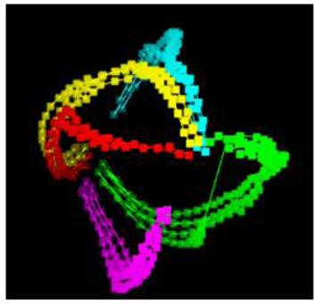
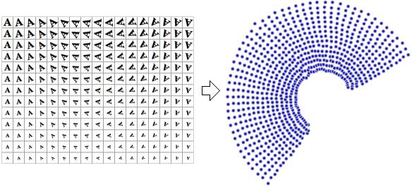
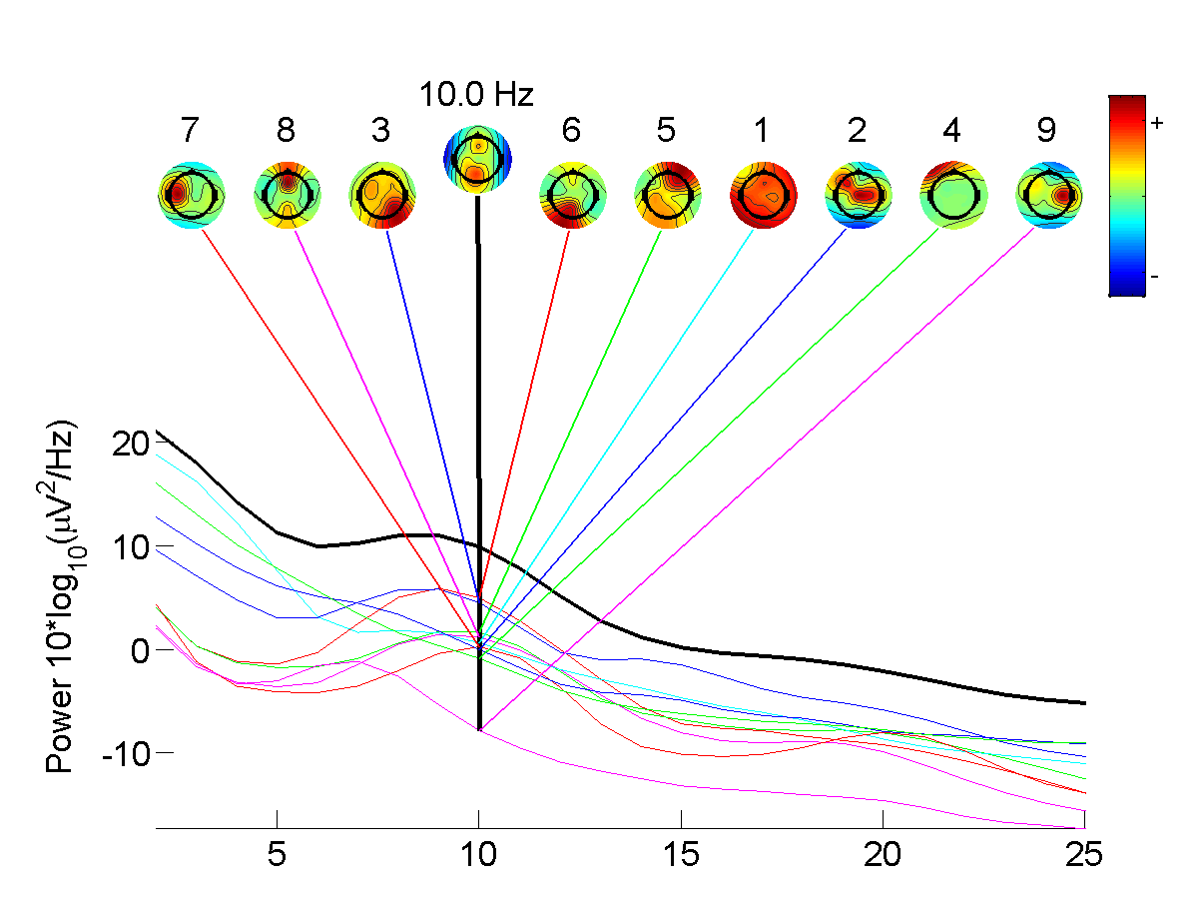
Motivation
Visualization
Discovering Structure
Data Compression
Noise/Artifact Detection
"Nldr". Licensed under Public Domain via Wikipedia - https://en.wikipedia.org/wiki/File:Nldr.jpg#/media/File:Nldr.jpg
"Lle hlle swissroll" by Olivier Grisel - Generated using the Modular Data Processing toolkit and matplotlib.. Licensed under CC BY 3.0 via Commons - https://commons.wikimedia.org/wiki/File:Lle_hlle_swissroll.png#/media/File:Lle_hlle_swissroll.png
"Independent component analysis in EEGLAB" by Walej - Own work. Licensed under CC BY-SA 4.0 via Commons https://commons.wikimedia.org/wiki/File:Independent_component_analysis_in_EEGLAB.png#/media/File:Independent_component_analysis_in_EEGLAB.png
http://scikit-learn.org/stable/auto_examples/manifold/plot_lle_digits.html

Slide 5
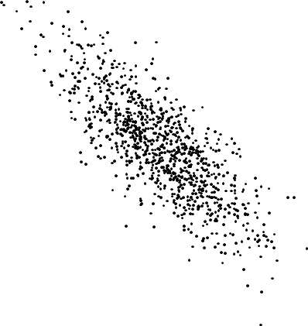
How to represent data?

Slide 6
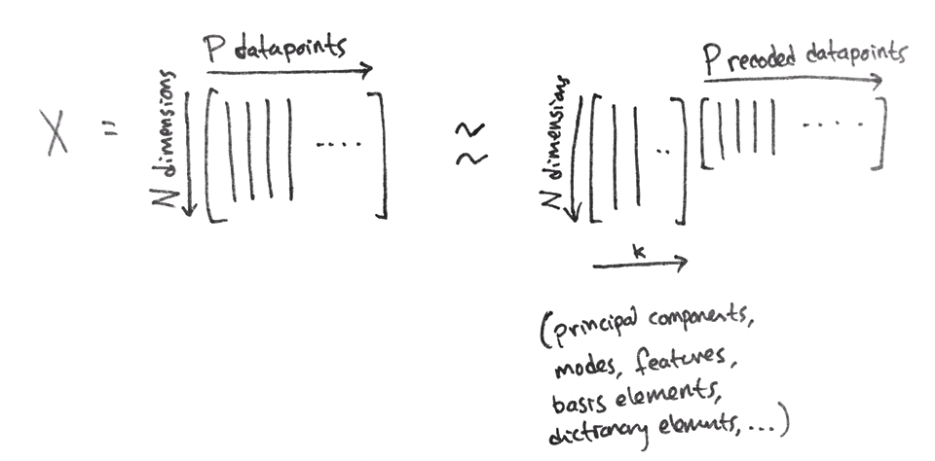
How to represent data?
Notes:
Introduce basis

Slide 7
How to represent data?
New basis

Slide 8
How to represent data?
Data in original basis
Data in new basis
New basis

Slide 9
How to represent data?
Data in new basis
New basis
Recode data

Slide 10
How to represent data?
New basis

Slide 11
How to represent data?
PCA finds the directions of greatest variance in your data, by calculating the eigenvectors of the covariance matrix.

Slide 12
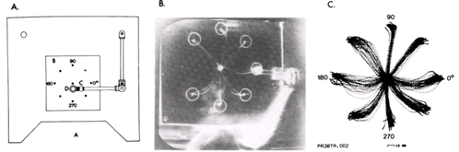
The Data
Spike data from monkey motor cortex, recorded when the monkey performed a reaching task
Georgopoulos et al, 1982

Slide 13
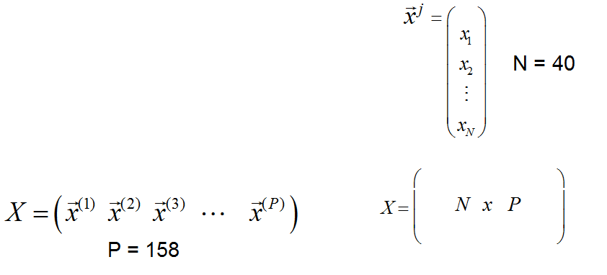
The Data
Spike data from monkey motor cortex, recorded when the monkey performed a reaching task
Each trial has 40 time points
There are 158 different trials
Georgopoulos et al, 1982

Slide 14
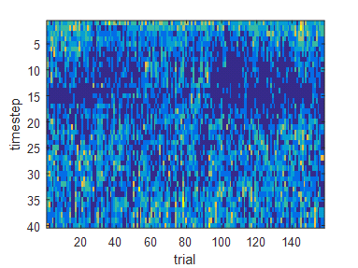
The Data
Each trial has 40 time points
There are 158 different trials
Georgopoulos et al, 1982

Slide 15
See MATLAB...
https://www.dropbox.com/sh/hreuhjzuqfe5rpj/AAC-LydSSpRm9Hce9HnIRtwRa?dl=0

Slide 16
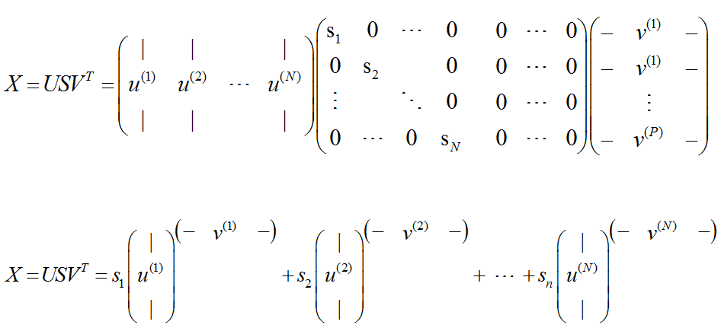
SVD (singular value decomposition)

Slide 17
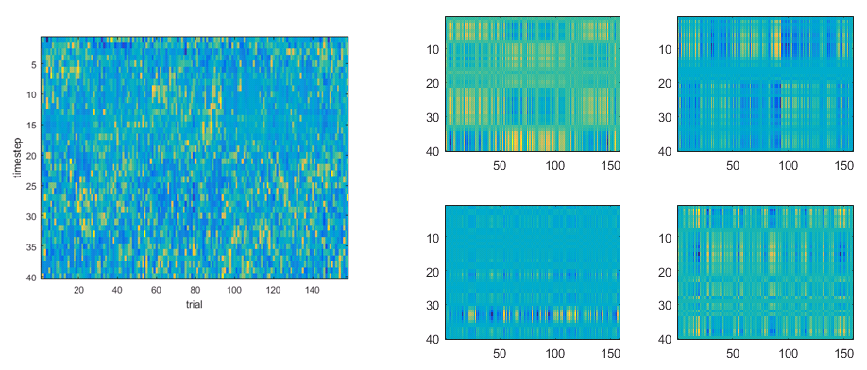
Rewrite mean-subtracted data as a linear sum of matrices

Slide 18
PCA can “fail”
variance
PCA discovers intrinsic structure of data
1st eigenvector
2nd eigenvector
… but you know there are two different classes (red and black).
PCA sees this...
Use Linear Discriminant Analysis instead

Slide 19
Dimensionality Reduction Taxonomy
Supervised | Unsupervised
Fisher LDA, Neural Network | PCA/SVD, ICA, t-SNE, ISOMAP, Neural Network
Linear | Non Linear
PCA/SVD, ICA, LDA | t-SNE, ISOMAP, MDS
Out of Sample Extension
Given new sample, can you reduce its dimension with a pre-learned mapping?
Mapping | Visualization
PCA, ICA, LDA | t-SNE, ISOMAP, MDS
https://en.wikipedia.org/wiki/Nonlinear_dimensionality_reduction

Slide 20
Summary
Dimensionality reduction
Removing information to emphasize information
PCA and SVD: powerful, unsupervised, linear methods
Enormous variety of techniques
Independent component analysis (Thursday)

Slide 21
References & Further Reading
Readings
http://research.microsoft.com/pubs/150728/FnT_dimensionReduction.pdf
https://lvdmaaten.github.io/publications/papers/TR_Dimensionality_Reduction_Review_2009.pdf
http://infolab.stanford.edu/~ullman/mmds/bookL.pdf
Software
https://lvdmaaten.github.io/drtoolbox/
python: LMNN http://www.shogun-toolbox.org/static/notebook/current/LMNN.html
http://www.cs.cmu.edu/~liuy/distlearn.htm

