Slide 1
An Introduction To Spike Sorting
Jai Bhagat & Caroline Moore-Kochlacs

Slide 2
Thanks to...
Carmen Varela, Francisco Flores, Jack Zhang, Mohsen Hozan, Morgan Siegmann, Matt Wilson, Hannah Wirtshafter, Brian Allen

Slide 3
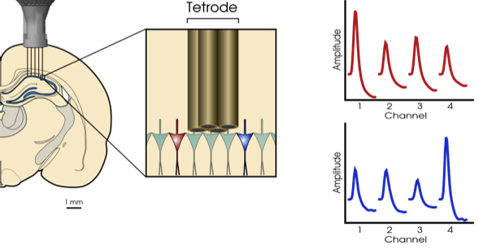
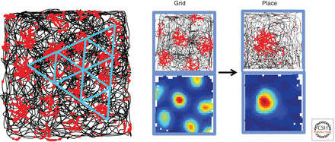
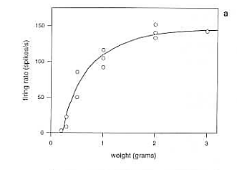
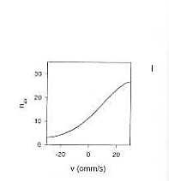
What is Spike Sorting and Why is it Important? it Important?
How does the brain encode information?
→ “Rate”/“Timing” coding
There is neuron specificity: place cells, grid cells, velocity cells, head direction cells, etc…
How does the brain guide behavior? → Coordination of neurons
Notes:
Start) Different neurons will have different relative positions to the tetrode wires, and will therefore have distinct AP waveforms. An underlying assumption is that APs coming from the same neuron will have roughly the same characteristics (i.e. shape), and so we will be able to classify APs as belonging to a specific neuron based on the AP characteristics.
“Spikes” by Rieke, edited by Poggio, elaborates on how neurons carry information both by rate coding (firing rate within a window) and also timing coding (precise temporal patterns of spikes within this window) (e.g. A1 neurons phase lock (rate code) to phase (frequency) of auditory stimulus
Caroline Runyan came and gave a talk last week? Mentioned and elaborated on these figures from this Moser paper on grid cells’ importance on decorrelating distinct hippocampal representations…Also things like edge detectors and orientation cells in V1
Here we see that two different types of LFP lent credence to the claim of meaningful interactions between PFC and CA1, but I think the strongest support for this claim comes from the fact that we can get down to the level of single neurons and show their coordination within these brain regions
*Note: Terminology: a spike is a putative action potential, and a unit is a putative neuron classified by its spikes
Last) Briefly mention how different sortings can really affect our downstream analyses -> can lead to invalid conclusions

Slide 4
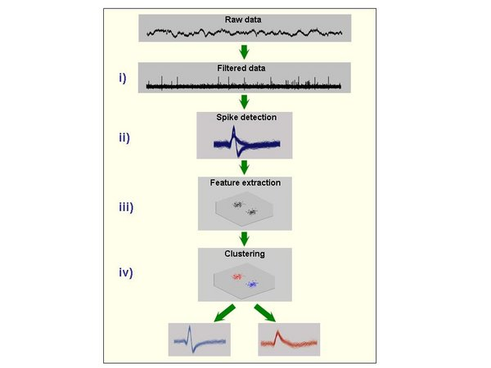
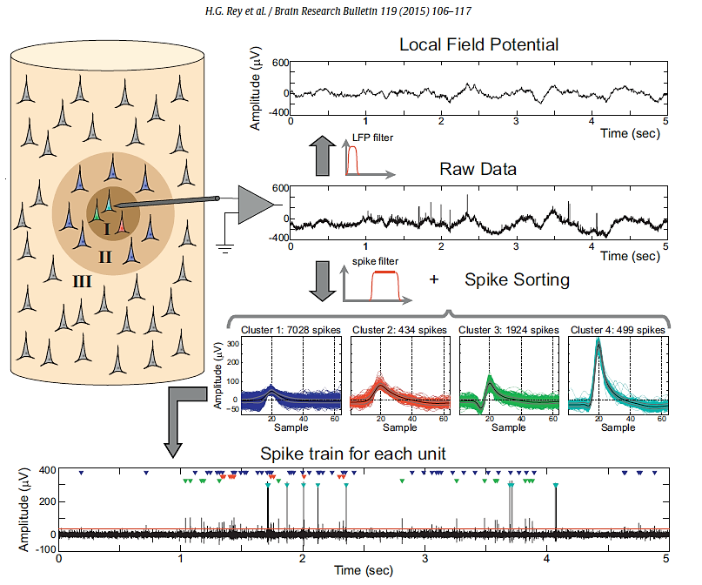
A Spike Sorting Workflow

Slide 5
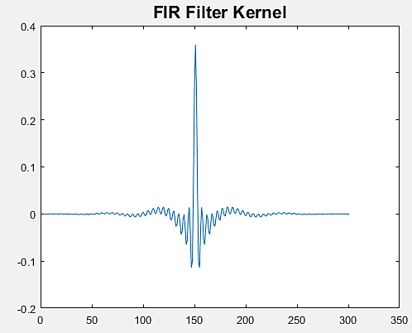
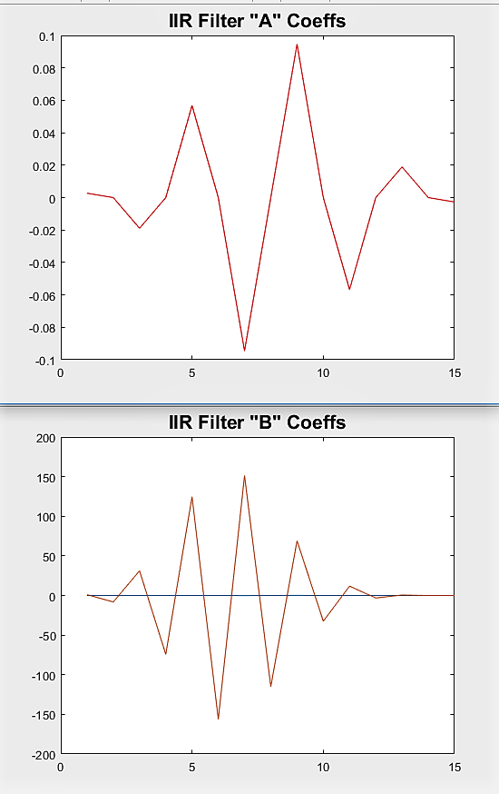
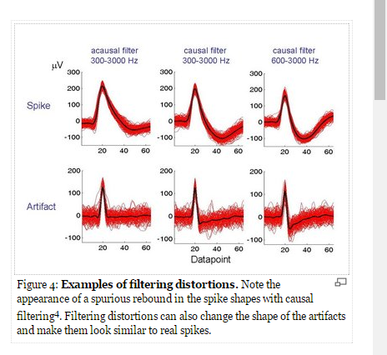
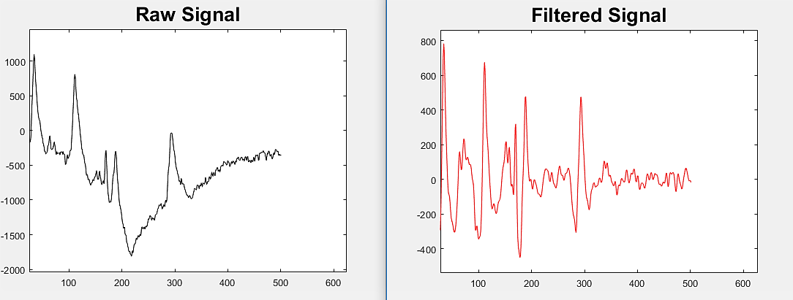
Filtering
Bandpass: 300-400 : 4000-7000
Finite Impulse Response vs. Infinite Impulse Response
Quian Quiroga

Slide 6
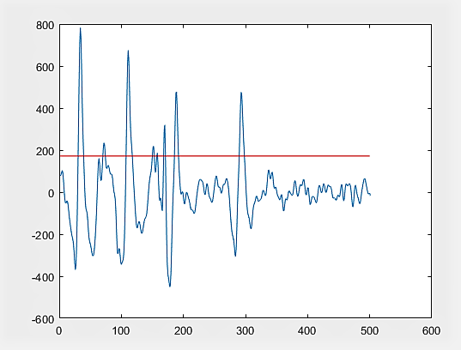
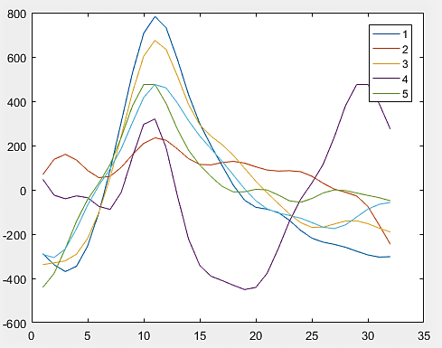
Spike Detection
Auto threshold: 5σ [where σ = median(abs(x)/.6745)]
Notes:
Talk about retriggering while still holding first spike
Mention other methods besides simple threshold: post-bandpass-filtering, pre-detection kernel which amplifies AP like shapes and attenuates noise

Slide 7
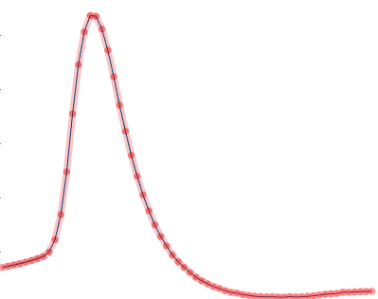
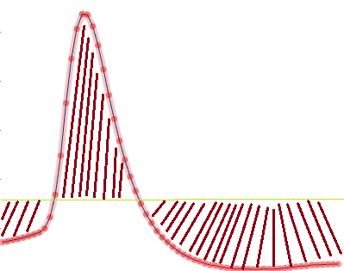
Extracting Spike Features
Features calculated directly from waveform
1) peak amplitude, 2) trough amplitude, 3) crest-to-trough amplitude, 4) width, 5) rise slope, 6) fall slope , 7) energy/power/rms
1
5
6
4
2
3
7
Notes:
Extracting Spike Features is all about reducing the dimensionality of our data before clustering – we want to extract features which allow us to group spikes into clusters most easily and accurately, where each cluster, again, is the putative source neuron of all spikes within

Slide 8
Spike Features
Features calculated through linear transformations of dataset
Principal Component Analysis
Discrete Wavelet Transform

Slide 9
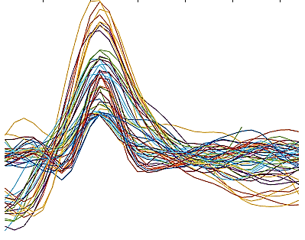
Principal Component Analysis
What is PCA and why would we use it for spike sorting?
PCA captures covariance between features of a dataset.
For purposes of sorting: spikes = instances of dataset samples = features of dataset
Notes:
use quick housing market example – we want to classify houses based on their similarity across all features
When we run PCA on a dataset, we are looking to capture useful information about the variance contained within the dataset.
This information about how each feature covaries with respect to every other feature (how each sample covaries with respect to every other sample) will be able to be used to classify waveforms to distinct units
So for each waveform, we will have 32 features (i.e. its samples). In this figure, we can already see that samples at and around the peak contain the most variance.

Slide 10
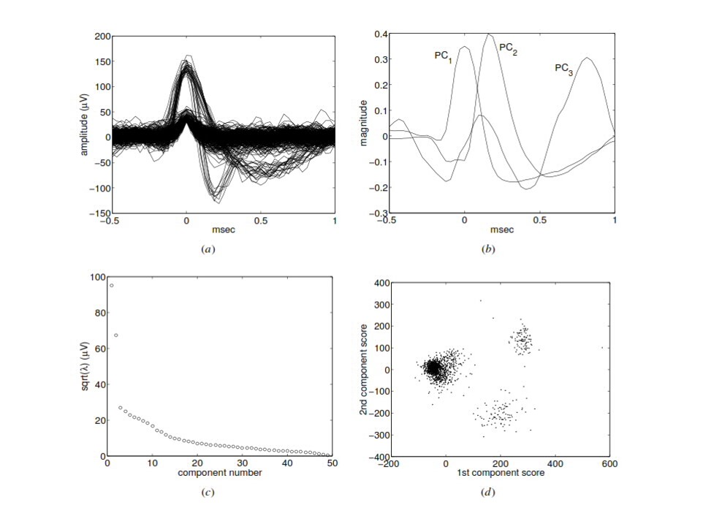
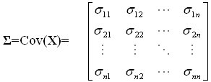
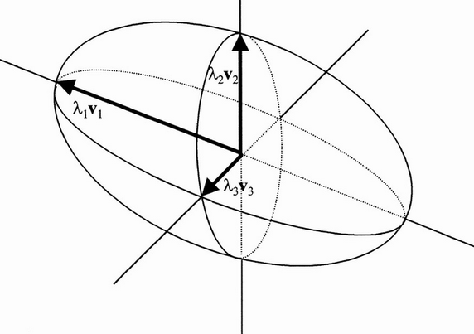
Principal Component Analysis
What does PCA look like when we implement it on a spike waveform dataset?
Lewicki
Notes:
This is an example of how two units have waveforms with essentially the same peak amplitudes (so their respective spikes would not be separable in peak amplitude space), but because the rest of their waveforms differ, they can be separable in PC space.

Slide 11
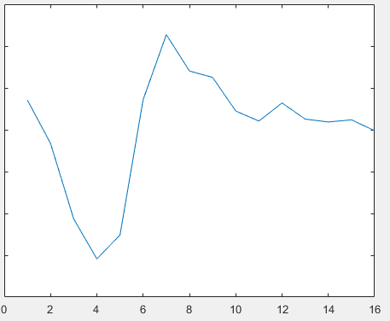
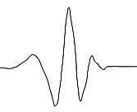
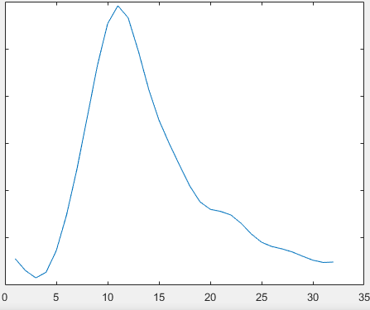
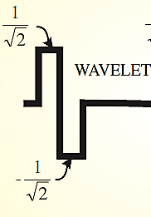
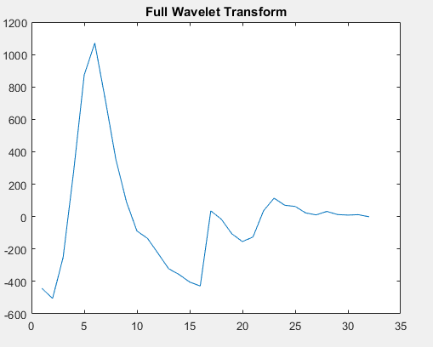
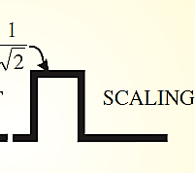
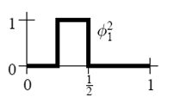
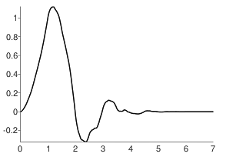
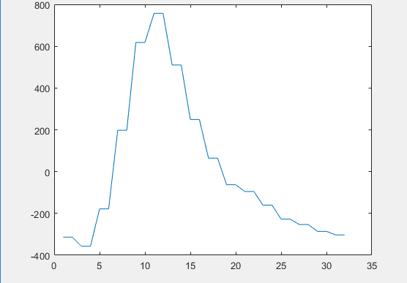
The Discrete Wavelet Transform
cD
What and why?
Spike
DWT
Wavelet
Scaling
cA
Haar
Daubechies-8
Notes:
3) By information here, I mean the energy of the signal.
3) a) In this way, its similar to PCA – how can we capture the essence of particular APs in the smallest amount of information possible?
- Interlude: what is the wavelet itself? -> a brief, wave-like oscillation. Every wavelet is a support signal (i.e. padded at both ends with zeros) that has two main conditions: zero average, finite energy, (there’s technically a 3rd condition which is finite norm of its Fourier transform, but that’s not important for visualization purposes). The reason for different types of wavelets is that different wavelets have different compression properties depending on the signal (e.g. DWT using Haar will compress a square wave function better than Daub-8, but Daub-8 will compress oscillatory signals better than Haar).
4) So our signal (a spike) is convolved with both 1) a wavelet (to separate out high-frequency components) and 2) a wavelet’s associated scaling signal (to separate out low-frequency components)

Slide 12
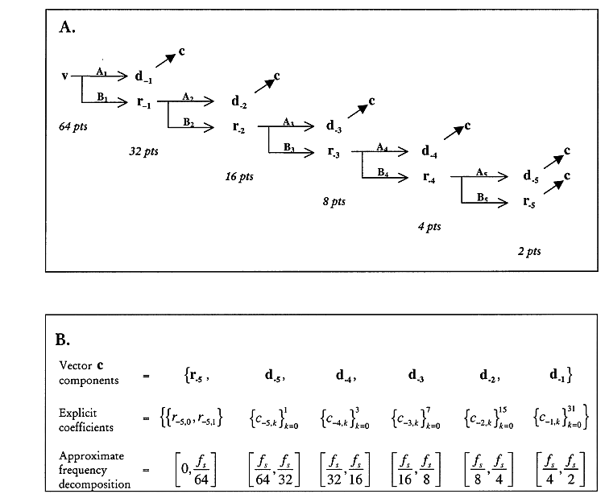
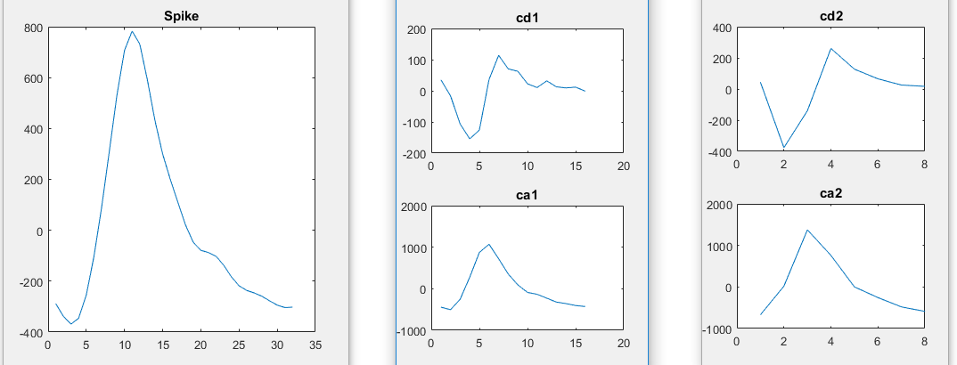
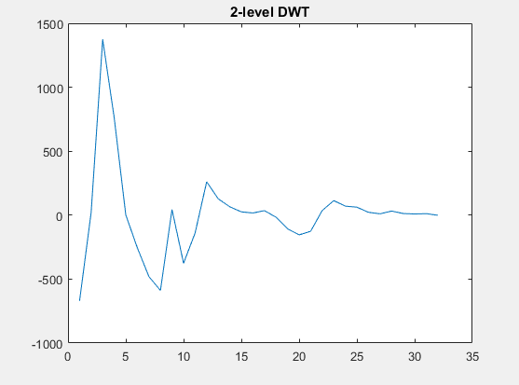
The Discrete Wavelet Transform
Multi-level transforms
Letelier
Notes:
We addend wavelet coefficients in a way in which we can reconstruct original signal

Slide 13
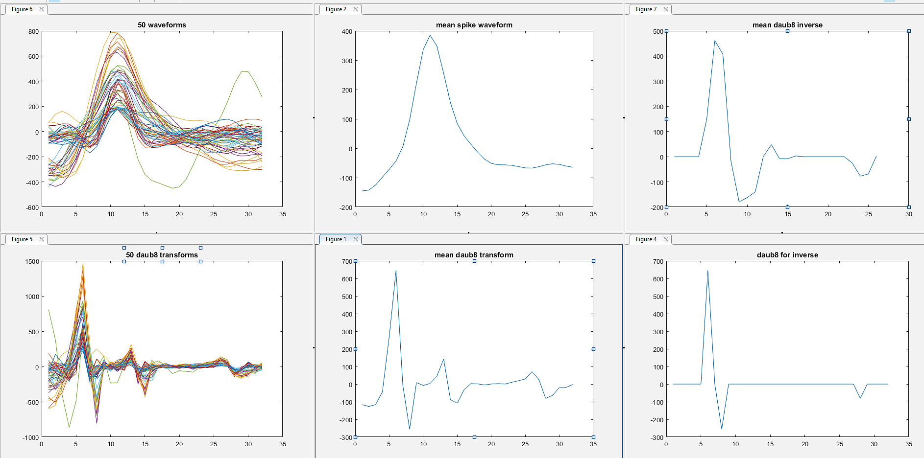
The Discrete Wavelet Transform
For Spike Sorting: we select coefficients with greatest variance
Notes:
Here, we want to use the wavelet coefficients with the greatest variance as features to sort with. Why? Similar to PCA – if they vary the most they’re giving you the most information about the dataset. Also, just like we sort on peak amps because they can distinguish between different classes of spikes, so do wavelet coefficients, but each wavelet coefficient contains more information about the entire signal (like PCs) than a simple peak amplitude.
(e.g., here wavelet coefficient 6 varies the most – the different values of this coefficient in the dataset correspond to different types of spikes, and thus most readily distinguish between different types of spikes)

Slide 14
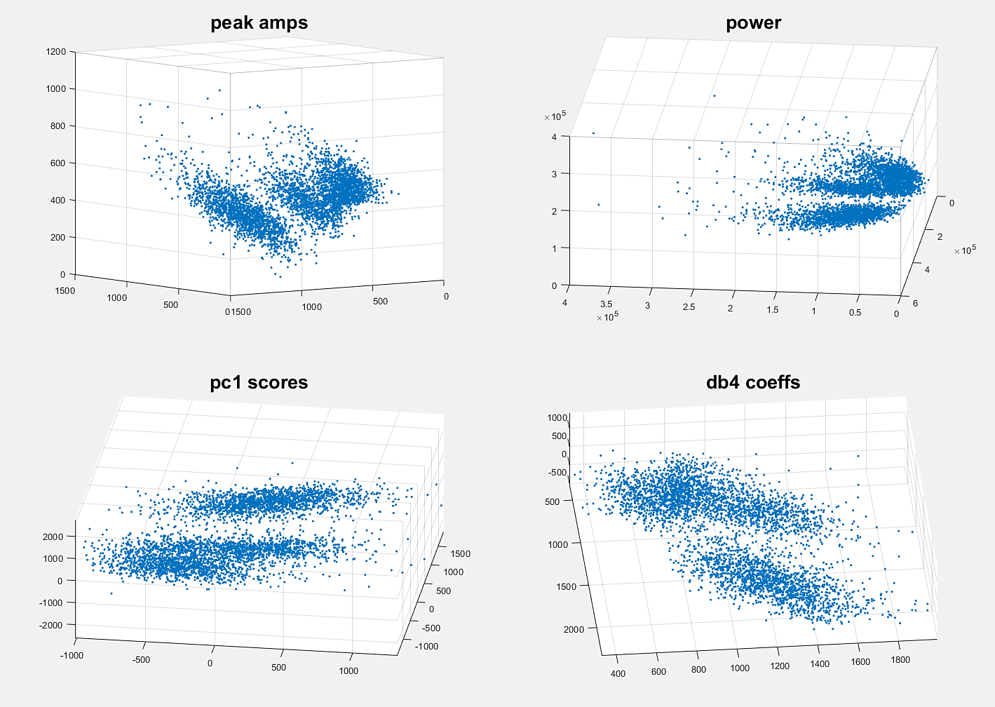
What do spikes look like in different feature spaces?

Slide 15
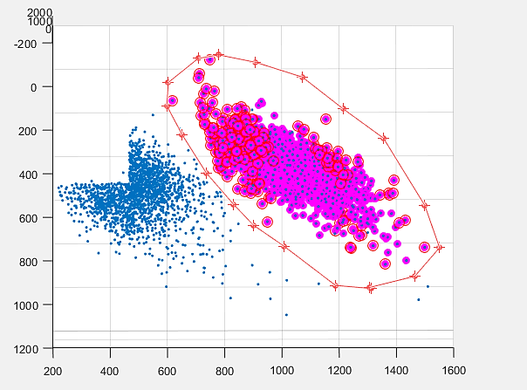
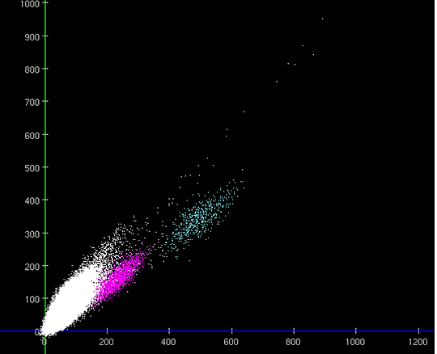
Clustering
Manual
Pros: 1) Completely user-defined, 2) Flexibility against sorting confounds
Cons: 1) Expensive (human) time cost, 2) Inherent variability & subjective biases

Slide 16
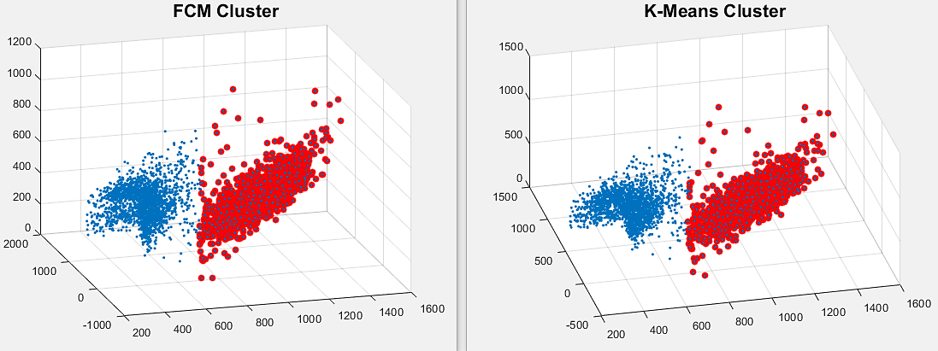
Clustering
Automatic: K-Means, Fuzzy C-Means, Hierarchical, SPC, etc…
Pros: 1) Inexpensive time cost, 2) Unaffected by subjective biases
Cons: 1) Inflexible against sorting confounds, 2) Prone to systematic errors
Notes:
1) Discuss semi-automated methods

Slide 17
Is any of this real?
Henze et. al. (2000)

Slide 18
Results from two ground truth datasets

Slide 19
Sorting in the Wilson lab: A short film

Slide 20
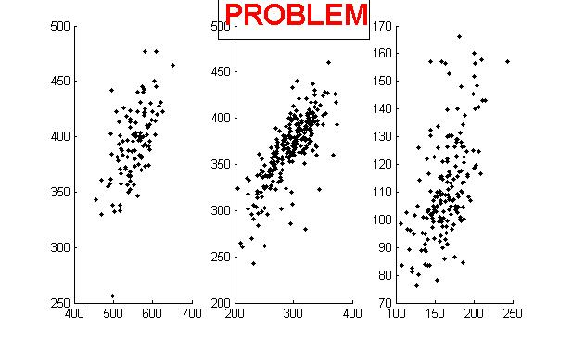
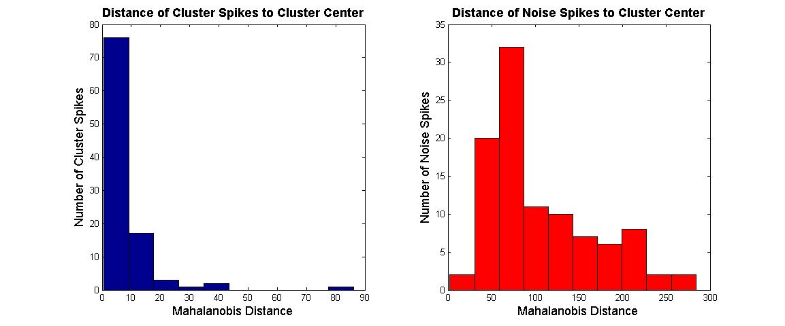
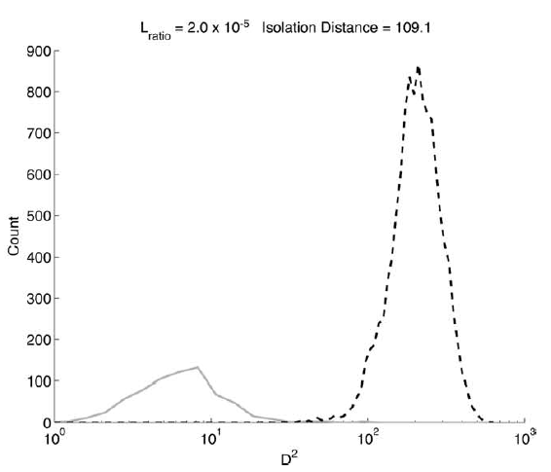
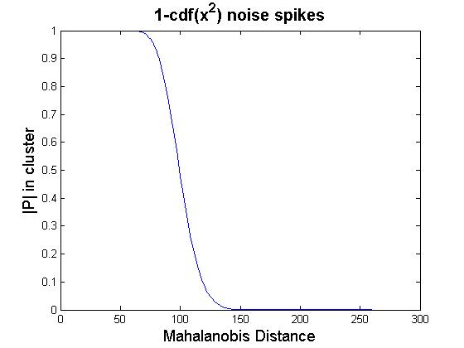
How can we assess our unit quality?
Quantitative approaches
Example: L-ratio
Notes:
Problem: Not MVN

Slide 21
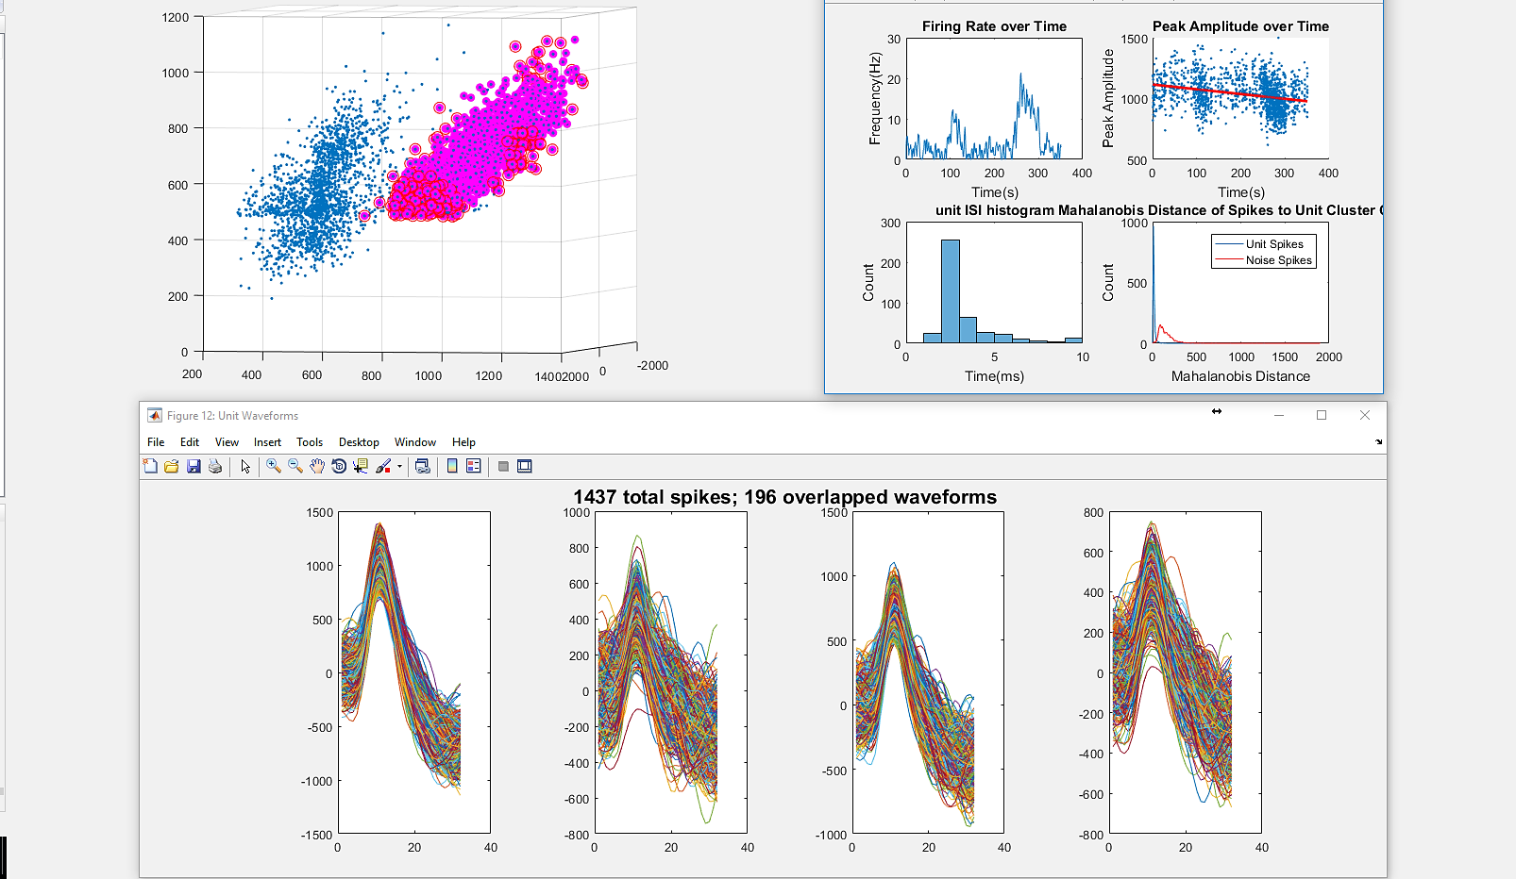
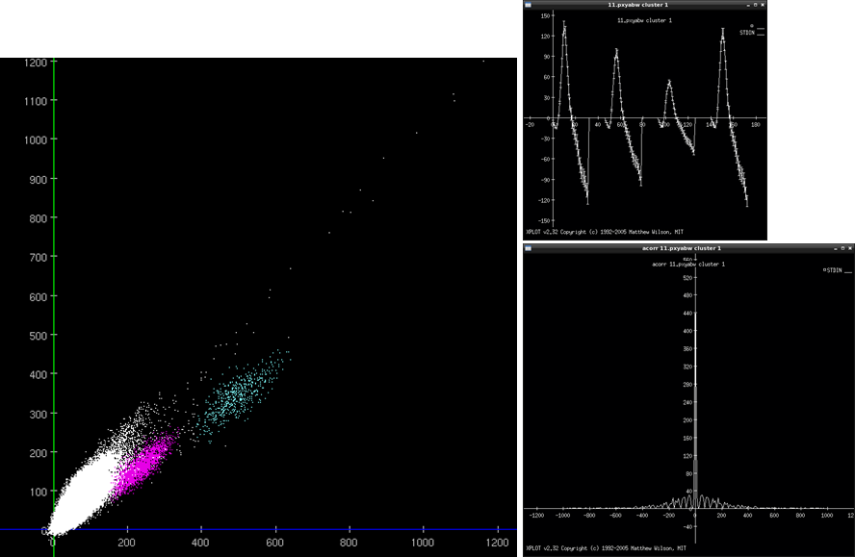
How can we assess our unit quality?
Qualitative Approaches

Slide 22
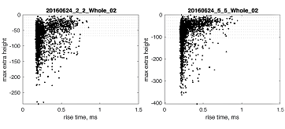
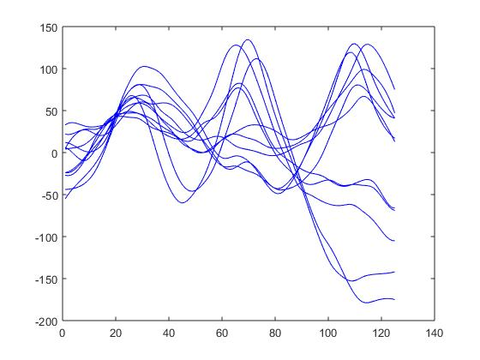
Sorting Biases & Confounds
Sorting is biased towards neurons with large magnitude action potentials and high firing rates
Confounds include:
Neuron bursting
Waveform overlaps of near-synchronous spikes
Back-propagation of dendritic action potentials
“Time-delayed” action potentials
Electrode drift
Biophysiological differences across brain regions

Slide 23
Helpful References
“Lewicki-Network-98_1.pdf.” Accessed March 22, 2017. http://stat.columbia.edu/~liam/teaching/neurostat-fall13/papers/EM/Lewicki-Network-98_1.pdf.
“Henze2000JNeurophys.pdf.” Accessed March 22, 2017. http://www.buzsakilab.com/content/PDFs/Henze2000JNeurophys.pdf.
Hill, Daniel N., Samar B. Mehta, and David Kleinfeld. “Quality Metrics to Accompany Spike Sorting of Extracellular Signals.” Journal of Neuroscience 31, no. 24 (June 15, 2011): 8699–8705. doi:10.1523/JNEUROSCI.0971-11.2011.
Schmitzer-Torbert, N., J. Jackson, D. Henze, K. Harris, and A. D. Redish. “Quantitative Measures of Cluster Quality for Use in Extracellular Recordings.” Neuroscience 131, no. 1 (2005): 1–11. doi:10.1016/j.neuroscience.2004.09.066.
Wood, Frank, Michael J. Black, Carlos Vargas-Irwin, Matthew Fellows, and John P. Donoghue. “On the Variability of Manual Spike Sorting.” IEEE Transactions on Bio-Medical Engineering 51, no. 6 (June 2004): 912–18. doi:10.1109/TBME.2004.826677.

